Slide 1
Continuing Professional Development for Teacher-Educators CPDC Induction CPDC Development Team
In association with the National Commission for Colleges of Education, Abuja
August 2015

Slide 2
Overview
Overview of core modules
Overview of elective modules
Overview of support and time commitment

Slide 3
Core 1: Teaching and learning methods
Overview of CPDC

Slide 4
Teaching and learning methods
Why this module?
Declining performance of school learners and changing societal needs.
Paradigm shift in terms of what is taught and how it is taught.
Need to equip teacher-educators to develop confidence and the honing of strategies for effective implementation of reform processes.
Underpins whole CPDC.

Slide 5
Teaching and learning methods
Content
Teaching as a profession (link to programme overview module)
Theories of learning
Methods and approaches in teaching and learning
Lesson planning, delivery and assessment
All based on practical examples

Slide 6
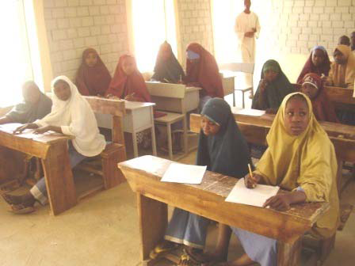
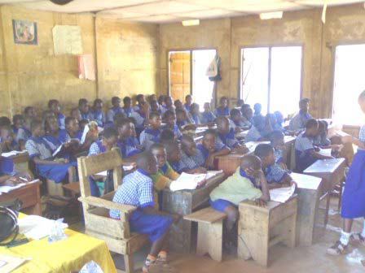
Traditional approach in teaching

Slide 7
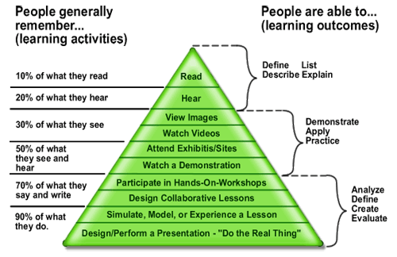
Cone of experience

Slide 8
Core 2: Learning resources
Overview of CPDC

Slide 9
Learning resources
Introduction
The NCCE curriculum reform calls for reform from teacher-centred to learner-centred teaching.
The module explores the potential of learning resources (LRs) in support of more interactive classrooms.
This is a very ‘hands-on experience’ and practical module.
This module is unique because it allows TEs to identify areas where the use of LRs would be beneficial,
explore current LRs that are available, as well as
design, develop, construct and examine the possible implementation of LRs for learning and teaching.

Slide 10
Learning resources
Purpose
To intimate TEs that he or she cannot teach effectively without LR.
To gain greater student interest and improved reading and literacy skills.
To shift towards construction of knowledge with less emphasis on passive learning.
To enable teacher-educators to do less of the talking during the interactions and allow learners to explore concepts more thoroughly.

Slide 11
Learning resources
Structure
Focus
Consolidation
Feedback

Slide 12
Learning resources
Outcomes
Units
Identify the sources of learning resources
Implement 'resource-based' and experiential learning in our classrooms
Units
Turn non-educational resources into good learning resources
Understand the relative educational strengths and weaknesses of different LRs
Units
Utilise the principles guiding the selection of LRs
Integrate Learning Resources into the learning activity
Design, construct, modify and adapt various LRs in our classrooms

Slide 13
Core 3: Educational technology
Overview of CPDC

Slide 14
Educational technology
Introduction
This module prepares teacher-educators to:
Overcome the challenging situations in our schools
Keep abreast of the current approaches to teaching and learning
Facilitate effective learning by getting learners more actively engaged in the learning process.

Slide 15
Educational technology
Content
This module comprises an introduction and five units.
Selection of appropriate educational technology for different class situations.
Selection of appropriate educational technology for different class needs.
Utilizing mobile learning technology for instruction
Accessing Open Educational Resources (OER) using Educational Technology for Instruction.
Challenges that come with developing and using educational technology materials

Slide 16
Educational technology
So, what’s new?
Emphasis on the ways in which educational technology can enhance teaching and learning rather than technology for the sake of technology.
Recognition that there are different technology needs and possibilities for different environments.
Educational technology possibilities cut across all areas of the CPDC programme and the wider curriculum.

Slide 17
Core 4: Special needs education
Overview of CPDC

Slide 18
Special needs education
Introduction and purpose
SNE is a core course under the new Minimum Standards.
Teacher-educators need a broad knowledge on categories of learners with special educational needs.
The approach is hinged on activity-based learning and also child-centred approaches.
There is a growing trend internationally towards Inclusive Education.
Therefore the CPDC will afford a continuous update on the use of a variety of generic teaching and learning pedagogies.

Slide 19
Special needs education
Unit One: Understanding special needs education
Topics under the unit:
What is inclusive education?
What are special educational needs?
Understanding and addressing special education needs in an African context
Impairments
Clarifying terminologies
Summary
Self-assessment

Slide 20
Special needs education
Unit Two: Supporting learners with special educational needs
Topics under the unit:
Supporting deaf or hard-of-hearing learners
Supporting blind or visually-impaired learners
Supporting mobility-impaired learners
Supporting behaviourally-challenged learners
Self-assessment

Slide 21
Special needs education
Central argument of the module
A move towards inclusive education approaches is an international trend.
It discourages segregation among children and neglect of individual potential
The use of resource- and activity-based learner-centred approaches enables every child to develop at his or her own pace and can also be cost-effective.

Slide 22
Any questions about the core modules?
Elective
TLM
LR
SNE
EdTech

Slide 23
Elective 1: ECCE/PES
Overview of CPDC

Slide 24
ECCE/PES
Purpose
Consequent to the new curriculum reform, it becomes imperative to prepare teacher-educators to deliver lessons effectively in both ECCE & PES through:-
Orientation to programme on new curriculum
Refresher courses on new course content on both ECCE/PES
Integration of appropriate technologies and learning resources.
New pedagogies & skills for the operation of basic instructional aids.
More inclusive classroom practice to accommodate greater diversity.

Slide 25
ECCE/PES
Structure
The module consists of seven units as listed below;
Units:
Orientation and Teaching Module for teacher educators-in ECCE/PES
Special training
Creating and maintaining appropriate learning environments
Application of constructivism in ECCE/PES and assessment practice
Music and dance
Nigerian Language in PES
Introduction to Ajami as a medium of writing

Slide 26
ACTIVITY
State two (2) types of traditional dance performed in your community during rituals and festive ceremonies.
List and explain the use of materials used in the production of traditional musical instruments in your community.
Plan, teach and reflect upon a lesson using the music and dance important in the development of culture in your community.
WE LIMITED OURSELVES TO THESE UNITS BECAUSE THE TWO FIELDS ARE BROAD AND CAN’T BE COVERED IN DETAIL AT ONE TIME

Slide 27
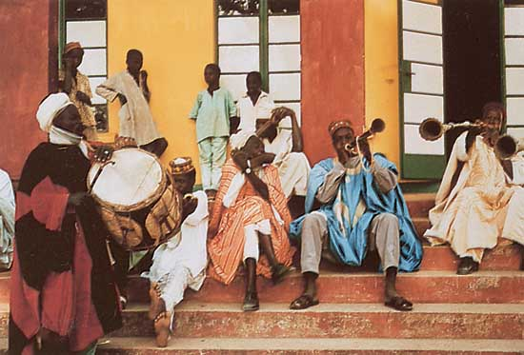

Slide 28
Elective 2: JSE
Overview of CPDC

Slide 29
Junior Secondary Education
Why this module?
The 2012 JSE curriculum reform requires teacher-educators to embrace new approaches to teaching.
In this module, we focus on the teaching of junior secondary mathematics and English.
The choice of English and mathematics was aimed at demonstrating how resources, methodology and technology can be integrated to reflect the learner-centred constructivist approach underpinning the reform of JSE curriculum as it affects all subjects.

Slide 30
Junior Secondary Education
Purpose
The main purpose of the programme is designed to help teacher-educators to:
“strengthen your understanding of mathematics and English topics
expand the range of instructional strategies that you can use in the mathematics and English classroom through the use of learner centred , activity and resource based approaches.
enable the development of relevant assessment instruments that will determine reliable and accurate achievement of learning outcomes.”

Slide 31
Junior Secondary Education
Contents
This module comprises six units as follows:
Part A
Multiplication of fractions
Two and three dimensional shapes
Angle of elevation and depression
Part B
The listening skills
The reading skills
The speaking skills

Slide 32
Junior Secondary Education
Rationale for choice of topics
The three topics in mathematics were chosen because students demonstrate difficulty in their learning and the examples will serve as models for teaching other topics in sciences.
Similarly, the three topics chosen in English are key to teaching other subjects and examples of exploring them in this module provide a guide for teaching particularly art subjects.
The aim is to guide teacher-educators to explore different ways of facilitating students’ understanding of concepts in these topic areas.

Slide 33
Elective 3: TVET
Overview of CPDC

Slide 34
TVET
Why TVET?
Why TVET?
Why focus on entrepreneurship?
Structure of the module,
Has 4 units:
Overview of the module and how it relates to the rest of the CPDC programme
Introducing TVET skills and learning resources
Teaching and learning of entrepreneurship education as a model for other TVET subjects
Entrepreneurial skills needed for TVET educators.

Slide 35
TVET
Activity progression
Entrepreneurial education is generic to TVET.
Introductory activities
Group discussion, brainstorming, reading assignments and online links.
Developmental activities
Scenarios and case studies
Consolidating activities
Application in an authentic context

Slide 36
TVET
Example activity
Activity 4.2 | Developmental activity This activity seeks to explore the relationship between experience and teaching. This activity should take about 15 minutes. Discuss the following in pairs using mobile technology such as Whatsapp. Share with each other the entrepreneurial skills you think you each possess. Considering the skills you have between you, what additional skills would you need to develop or recruit to start a successful new small business. How would you go about acquiring these additional skills? Now think about these questions again in relation to your teacher-students. How can you teach them in such a way that they develop the full range of entrepreneurial skills they need? What are the alternatives for people who are not entrepreneurially inclined?

Slide 37
Elective 4: ANFE
Overview of CPDC

Slide 38
Adult and non-formal education
Why this module?
There is growing need internationally for lifelong learning in the 21st century global knowledge economy.
ANFE is newly introduced into the NCE curriculum.
Teacher-educators are more conversant with pedagogy and therefore need an orientation to andragogy.
To help teacher-educators work with adults most effectively, they need capacity-building in resources, technologies and strategies most appropriate for teaching in an adult context.
Hence, the need for this module.

Slide 39
Adult and non-formal education
Content
Unit 1- Principles of adult learning: The unit identifies the key principles which underpin adult learning.
Unit 2- Concept and types of andragogy: This unit introduces the concept, theories and type of methods which underpin adult learning.
Unit 3- Learning resources for adult learning: This unit deals with guidelines for the selection and the procurement of learning resources appropriate for adult learners.
Unit 4- Language and communication skills: This unit identifies some of the key knowledge and skills needed in adult classrooms.

Slide 40
Adult and non-formal education
What is unique about the approach in this module?
It uses approaches to learning that are problem-based and collaborative rather than didactic.
This module involves activity-based learning which engages teacher- educators to work either individually, in pairs or in groups.
Each unit component has its own unique activities at introductory, developmental and consolidating stages.
Example, “Andragogy (Adult Learning)” http://youtu.be/vLoPiHUzbEw. This video takes us to an activity that will require teacher educators to analyse, discuss and relate to their classroom practices.
Thus the module provides the teacher-educators with the resources, technologies and strategies most appropriate for teaching in an adult context.

Slide 41
Any questions about the electives?
Elective
1 of 4
TLM
LR
SNE
EdTech

Slide 42
Support and time commitment
Overview of CPDC

Slide 43
Implementation model
Orientation
1-hour orientation for all college lecturers.
Printed copies of programme outline and Orientation module
2-weeks to work through Orientation module
3-hour debrief and registration (including choice of elective) and receipt of digital materials on flashdrive and printed materials for core modules (electives to follow)
Agreement on start date of 20-week/2-semester programme

Slide 44
Implementation model
Contact sessions
Weekly (3h) or fortnightly (6h)
Orientation (including prior learning and experience and assessment)
Maintenance (including modelling and assessment feedback)
Consolidation (including portfolio)

Slide 45
Any questions about support?
Orientation
Maintenance
Consolidation

Slide 46
Registration
Remember: 4 core modules
TLM, LR, EdTech, SNE/IE
And one elective
ECCE OR JSE OR TVET OR ANFE
We will meet for our first contact session on XXX in XXX at XXX.
If you need to get hold of me between now and then:
Office:
Mobile:
Email:

Slide 47
Thank you for listening

